Slide 1


Banking activity simulation
A comprehensive guide to building enterprise-grade authentication, transaction security, and customer management for fintech applications
Presented by: Anushree Joshi
Thivagar
Archana
Notes:
1

Slide 2









Multi-Layered Security Foundation
Security isn't a feature—it's the foundation. Our architecture implements defense-in-depth strategies to protect customer data and financial transactions at every layer.
BCrypt Hashing
All passwords and PINs encrypted using BCrypt—never stored in plain text. Auto-rehashing ensures legacy credentials stay protected.
Two-Factor Authentication
OTP-based 2FA via email or SMS adds critical second layer. Required for sensitive operations like admin access and PIN generation.
Account Locking
Automatic lockout after 3 failed login attempts prevents brute force attacks. Admins can review and unlock accounts through secure dashboard.
Auto-Logout Protection
Sessions automatically terminate after 1 hour of inactivity, minimizing exposure from unattended devices in public or office environments.
Notes:
2

Slide 3

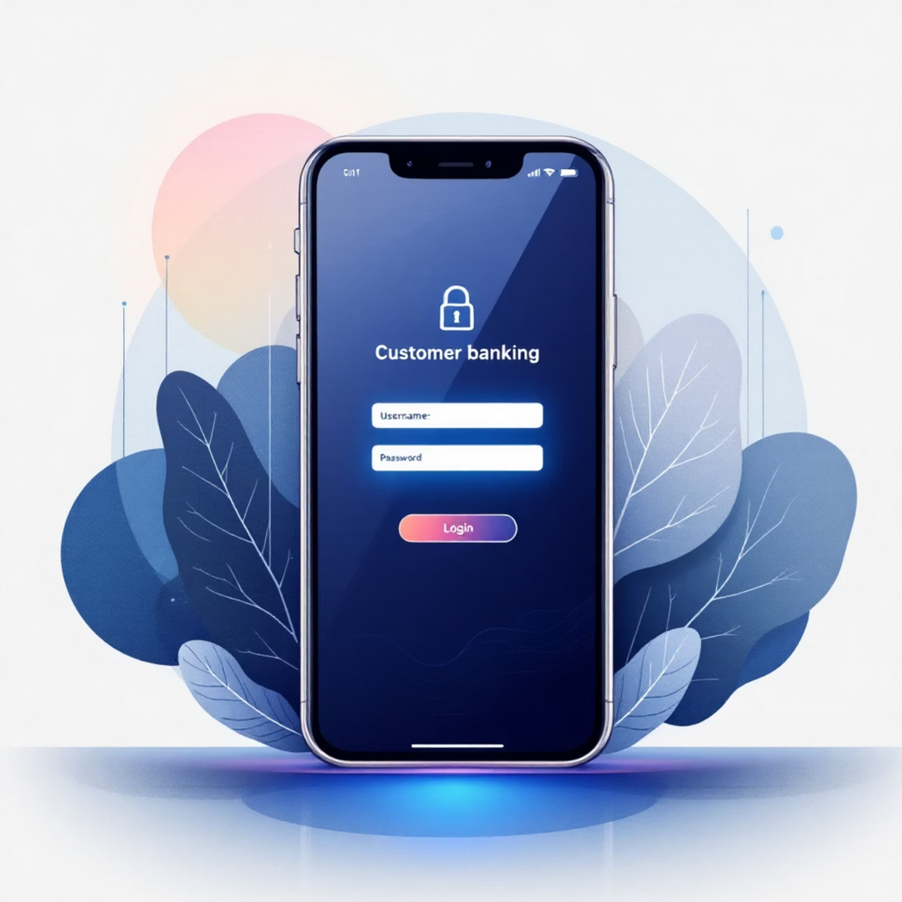
Dual Authentication Architecture
Admin Access
Customer Access
Mandatory OTP verification for every login session
Secure login with BCrypt-hashed credentials
Protected default admin account cannot be deleted
Optional 2FA for enhanced account protection
Privileged access to all system functions and reports
Transaction PIN required for financial operations
Full audit trail of administrative actions
Self-service dashboard with full account visibility
Notes:
3

Slide 4




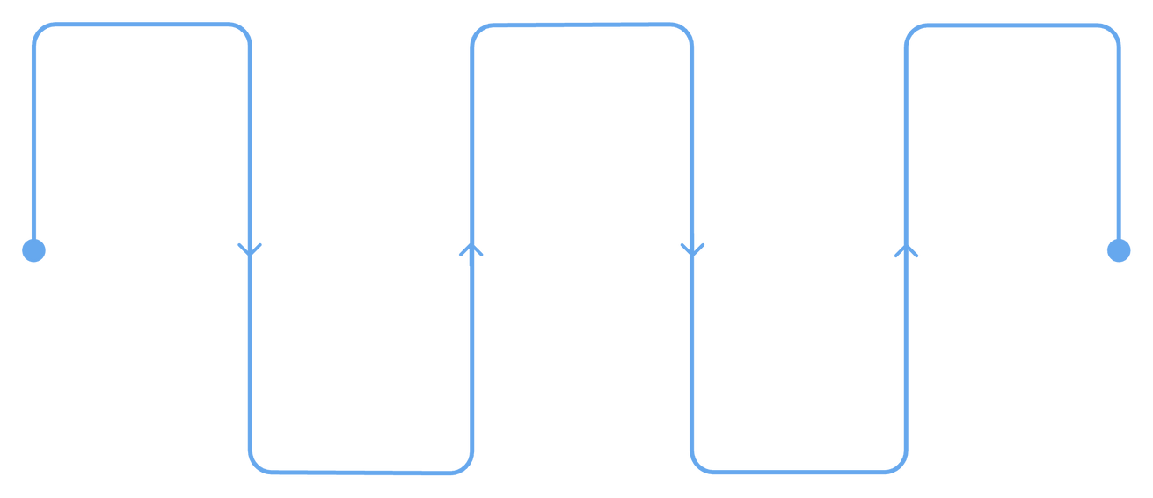

Customer Dashboard Capabilities
Account Management
View real-time balance, IFSC code, branch details, and complete transaction history with downloadable mini-statements.
Transactions
Deposit funds, withdraw cash, and transfer money—all protected by PIN verification and recipient validation checks.
Discover
Execute
Optimize
Identify needs and goals
Implement solutions and tests
Refine based on insights
Plan
Measure
Develop roadmap and milestones
Track outcomes and metrics
Loan Services
Track active loans, enable auto-repayment toggle, request early closure, and manage EMI schedules from one central hub.
Security Controls
Generate transaction PINs, request account deletion, and manage security preferences with OTP-verified authorization.
Notes:
4

Slide 5

Admin Control Center
Comprehensive administrative tools for managing the entire banking ecosystem with enterprise-grade security and oversight capabilities.
Customer Management
Create new customer accounts, update existing profiles, view complete customer portfolios, and manage the full customer lifecycle from onboarding to closure.
Security Operations
Monitor locked accounts, unlock after verification, review failed login attempts, manage admin users, and maintain system-wide security posture.
Deletion Requests
Review account closure requests with full context: customer details, loan status, transaction patterns. Approve or reject with detailed comments and rationale.
Reports & Analytics
Generate password-protected PDFs for accounts and transactions. Filter by branch, export comprehensive data, and maintain compliance documentation.
Notes:
5

Slide 6

Transaction PIN Security Layer
PIN Generation
BCrypt Storage
Customer initiates PIN creation from dashboard with OTP validation required
PIN immediately hashed and encrypted before database storage
1
2
3
4
10-Second Display
Transaction Verification
PIN shown only once for 10 seconds—user must save it securely
PIN required for withdrawals, transfers, loans, and auto-repayment activation
Security Best Practice: The transaction PIN creates a critical separation between account access and financial operations. Even if login credentials are compromised, the PIN provides an additional barrier protecting customer funds.
Notes:
6

Slide 7
Loan Request & Approval Workflow
Step 1: User Application (Frontend)
User navigates to the "Loan Center" on the dashboard.
Inputs: Loan Amount and Duration (e.g., 12, 24, 60 months).
Step 3: Administrative Review (Management)
Bank Administrators view pending applications in the Admin Dashboard.
Admin verifies user eligibility (e.g., Credit Score, Account Balance).
Step 4: Finalization & Disbursement
If Approved: Status updates to APPROVED in the database. The loan principal is credited to the user's main balance.
If Rejected: Status updates to REJECTED, and the user is notified.
Step 2: Secure Database Entry (Backend)
The application data is validated by the Controller.
A new record is created in the MySQL loans table via LoanDao.
Default Status: Set to PENDING.
The request is linked to the user's account_number via a Foreign Key.
Admin Review Process
Analyze transaction history and average balance
Review uploaded documents and customer profile
Approve with automatic fund disbursement
Reject with detailed comments and guidance
Upon approval, principal + interest added to account. Auto-repayment cycle begins on the 5th of each period with email alerts for insufficient funds.
Notes:
7

Slide 8
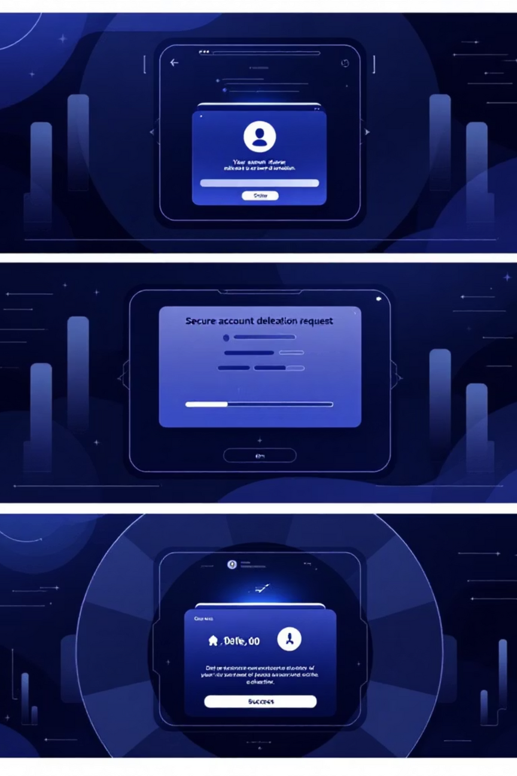



Account Deletion Request System
Customer Initiates
Submit closure request with holder name, account details, PIN validation, and reason. Immediate email confirmation sent.
Admin Reviews
View complete customer profile, loan status, and transaction history. Admin provides approval or rejection with detailed comments.
Resolution
Approved: Account flagged as deleted, customer notified. Rejected: Request reset with explanation emailed to customer.
"Account deletion requests are processed within 48 hours. Our thorough review ensures all outstanding obligations are settled and customer data is handled responsibly."
Notes:
8

Slide 9




Automated System Intelligence
Auto-Repayment Processing
Inactive Account Detection
Scheduled EMI deductions on the 5th of each cycle period. System sends advance reminders and handles insufficient balance gracefully with customer notifications.
Automatically flags accounts with no activity for 6+ months. Triggers compliance workflows and enables targeted re-engagement campaigns.
Intelligent Reporting
Comprehensive Audit Logging
Generate password-protected PDFs with branch filtering. Accounts reports, transaction summaries, and mini-statements with AstroNova branding and timestamps.
System logs every security event: logins, failed attempts, locks/unlocks, deletions, loan decisions, and auto-repayment transactions for compliance.
Notes:
9

Slide 10

Database Architecture & Security
MySQL-powered backend with optimized table structures supporting real-time transactions, comprehensive audit trails, and enterprise-scale performance.
Core Tables
Security Tables
Loan Management
users: credentials, rolesaccounts: balances, IFSC, branchtransactions: complete history
otp_verification: 2FA codesaudit_log: system eventsdeletion_requests: closure tracking
loan_requests: applicationsTracks: amount, interest, EMI plan, repayment status, auto-debit cycle
This architecture ensures data integrity, enables real-time processing, supports regulatory compliance, and scales efficiently for growing customer bases while maintaining millisecond response times.
Notes:
10

Slide 11
CONCLUSION:
Successful Deployment: Developed and deployed a fully functional, secure Banking Management System (SEFANA).
Objective Met: Achieved the goal of simulating core banking operations (Transactions, Loans, Admin Management) within a secure 3-tier architecture.
Key Learning: Gained hands-on expertise in Java Spring Boot, JDBC Connectivity, SHA-256 Security, and Full-Stack Integration.
Impact: The system effectively bridges the gap between secure backend logic and a modern, user-friendly frontend.
Future Scope (Roadmap):
Payment Gateway Integration: Implementing real-time payment processing (e.g., Stripe/Razorpay) for external transfers.
AI-Powered Support: Integrating an AI Chatbot to assist users with balance inquiries and loan eligibility 24/7.
Mobile Application: Extending the platform to a mobile app using React Native for on-the-go banking.
Cloud Deployment: Deploying the application on AWS or Azure to ensure high availability and scalability.

